Slide 1


Customer Segmentation using K-Means Clustering
Presented by Ruchita Jadhav

Slide 2

Introduction:
Have you ever received a promotional offer that felt like it was made just for you?
That's the power of customer segmentation!
In today's competitive market, understanding customer behavior is not just nice-to-have - it's essential for survival.
This project uses AI to uncover hidden customer patterns and transform how businesses connect with their audience.
Goal: Segment customers using spending patterns and income to deliver actionable marketing insights.

Slide 3
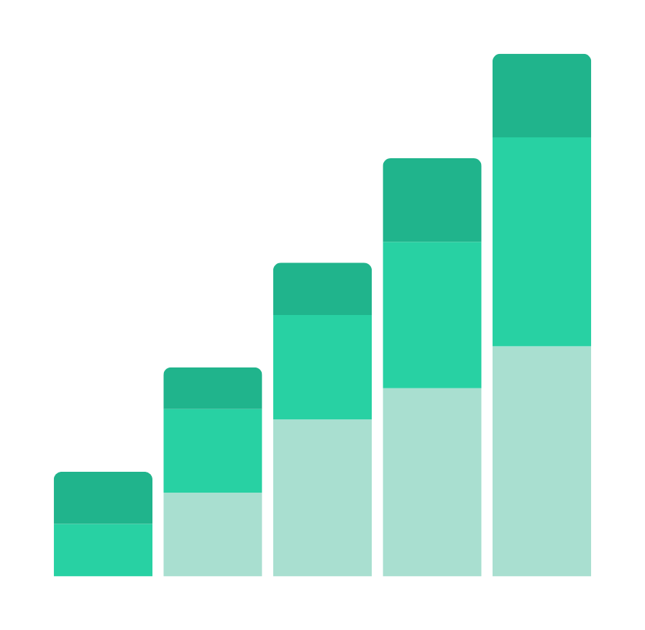
Objective:
Segment customers into meaningful groups based on income and spending.
Identify groups such as:
High-income, high-spenders → “Luxury Buyers”
Low-income, low-spenders → “Budget Customers”
High-income, low-spenders → “Potential Customers
Provide actionable recommendations for business strategies.
Provide data -driven marketing strategies.
Enable personalized customer experiences.

Slide 4

Dataset Overview
Dataset Source:
Mall Customers Dataset (200+ customer records)
Key Features Used:
Age – demographic context
Annual Income (k$) – purchasing power
Spending Score (1–100) – customer engagement and buying behavior
Data Format:
CSV, clean and pre-processed, ready for analysis
Rationale for Feature Selection:
Income → segment customers by financial capability.
Spending Score → identify engagement patterns and high-value potential.

Slide 5
Tools & Libraries:
Python ,Google colab
Pandas → data manipulation
Matplotlib & Seaborn → data visualization
Scikit-learn → K-Means clustering

Slide 6
Methodology
01.
02.
03.
Determine Optimal Number of Clusters
Used Elbow Method to identify the ideal number of customer segments.
Plotted Within-Cluster Sum of Squares (WCSS) against cluster numbers.
Selected the point where adding more clusters does not significantly improve segmentation (Optimal K = 5).
Apply K-Means Clustering
Grouped customers into 5 clusters based on similarity in income and spending behavior.
Each cluster has a centroid, representing the average profile of that segment.
Feature Selection
Chose Annual Income andSpending Score as key features.
Reason: Income reflects purchasing power; spending score indicates customer engagement.

Slide 7
Methodology
04.
05.
Visualization
Created scatter plots showing clusters and centroids.
Color-coded clusters to easily distinguish between different customer groups.
Insights Extraction
Analyzed cluster characteristics (income, spending) to derive actionable business strategies.
Identified which segments to target with premium offers, promotions, or engagement campaigns.

Slide 8

From Data To Actions:
1. 🏆 HIGH-VALUE CUSTOMERS
• Profile: High income + High spending
• Strategy: Target premium products & personalized marketing
• Action: Exclusive offers, VIP treatment, personal shopping
2. 💼 HIGH-INCOME, LOW SPENDERS
• Profile: High income + Low spending
• Strategy: Engage with campaigns to increase spending
• Action: Demonstrate value, build trust, showcase benefits

Slide 9
From Data To Actions:
3. 🌟 LOW-INCOME, HIGH SPENDERS
• Profile: Low income + High spending
• Strategy: Offer budget-friendly products & upselling
• Action: Great deals, loyalty rewards, value bundles
4. 📝 LOW-VALUE SEGMENT
• Profile: Low income + Low spending
• Strategy: Focus on discounts and affordable offers
• Action: Essential products, clearance sales, basic deals
5. ⚖️ MODERATE SEGMENT
• Profile: Balanced income & spending
• Strategy: General promotions & loyalty programs
• Action: Volume discounts, seasonal offers, member benefits

Slide 10
Results
1. Optimal Number of Clusters (Elbow Method)
Using the Elbow Method, the optimal number of clusters was determined to be 5.
Plot saved as: Elbow_Method.png
Ensures balance between segmentation accuracy and simplicity.
2. Customer Segmentation (K-Means Clustering)
5 distinct clusters identified based on Annual Income and Spending Score.
Scatter plot saved as: Customer_Segments.png
Cluster centroids highlighted to show the “average profile” of each segment.
3. Cluster Summary with Business Interpretation saved as Cluster_Summary.csv

Slide 11

Thank you very much!

